Slide 1

ARUSHA TECHNICAL COLLEGE
ELECTRICAL ENGINEERING DEPARTMENT
PROJECT PRESENATION
PROJECT TITLE : INTELLIGENCE PASSWORD BASED CIRCUIT BREAKER WITH WEB SERVER .
NAME OF STUDENT : JUMA YUNUS MHANDO
ADMISSION NUMBER : 22030712118
NTA LEVEL 6
ACADEMIC YEAR (2022/2023).
COURSE: ORDINARY DIPLOMA IN ELECTRICAL ENGINEERING

Slide 2
INTRODUCTION
Circuit Breaker is an electrical safety device designed to protect an electrical circuit from damage caused by an overcurrent or short circuit.
INTELLIGENCE PASSWORD BASED CIRCUIT BREAKER WITH WEB SERVER is an electronic system designed especially for the purpose of protecting the safety of technicians while they are working after it appears that maintenance is needed in the relevant part. This system enables the relevant technician to turn off the power line he is working on until he is done. and it will also prevent anyone who wants to turn on the system if he was not the person who turned it off in the beginning.

Slide 3
Problem statement
Troubleshooting in the electrical industry has become a daily thing and requires a very high level of safety to ensure the lives of technicians are always safe in their daily work. in order to facilitate this, it is better to have a system that will enable the technician to ensure his work safety by turning off the electricity in the line he can work on with a special code that will enable him only to turn on the line if he finishes the maintenance
These codes can be a number system or a long string of passwords and the other way to turn on this system is to turn it on in two ways, one is to turn it on physically and the other to turn it on using a web server.

Slide 4
PROJECT OBJECTIVES
MAIN OBJECTIVE
The main objective of this project is to design and implement INTELLIGENCE PASSWORD BASED CIRCUIT BREAKER WITH WEB SERVER.
SPECIFIC OBJECTIVES
To design the circuit of proposed system
To simulate the control circuit using simulation software.
To implement and test system prototype

Slide 5
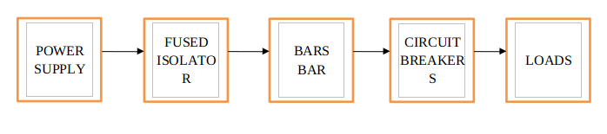
LITERATURE REVIEW
Existing system
The existing system the circuit breakers are connected direct with the busbars from the supply line to the transmission line
Disadvantages of existing system
Loss of vacuum due to transit damage or failure makes the entire interruption useless and it cannot be repaired in site.
It need additional surge suppression in parallel with each phase for interruption of low magnetizing currents in certain range.

Slide 6
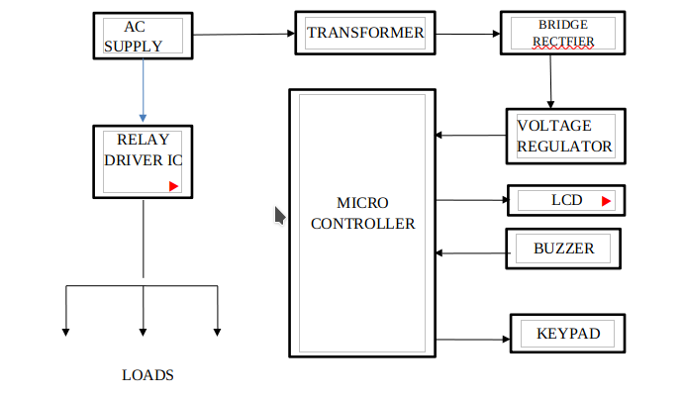
Proposed system
Advantages of the proposed system
It avoids electrical and mechanical accidents to workers and maintenance team.
This project is very simple and easy in construction and implementation.
It can be built with commonly available components.
It give no scope of password stealing
It is effective on providing safety on working staff.
It can be easily installed.

Slide 7
METHODOLOGY
Introduction
Literature review
Data collection
Data Analysis
Circuit Designing and Simulation
Implementation and Testing

Slide 8
THE END
THANK YOU

